Slide 1
CAPCONNECT | THE PROBLEM STATEMENT
A Preventable Crisis Hiding in Plain Sight
In the world many elderly people and patients forget to take their medicines on time. This often leads to missed doses or taking the same medicine twice. As a result, a large number of people face avoidable health problems, hospital visits, and added medical costs for families and the healthcare system.
50%+
of patients forget to take their medication as prescribed.
100,000s
of preventable hospitalizations every year.
$Billions
in added strain on global healthcare systems.

Slide 2
CAPCONNECT | WHY PATIENTS STOP TAKING THEIR MEDICATION
Medication Non-Adherence by the Numbers
NON-ADHERENCE METRICS
Patient Cohort | Non-Adherence Rate | Primary Behavioral Driver
General Population | 50% | Forgetfulness / unintentional omission
Elderly Population | 55% | Forgetfulness / complex scheduling
10–12%
of patients are hospitalized annually due to adverse drug events.
$200–300B
approximate annual cost of hospitalizations and medical care from adverse drug events.
Across every cohort, the leading reason patients stop taking their medication isn’t intent—it’s memory. Forgetfulness, compounded by complex schedules, drives non-adherence higher with age.

Slide 3
CAPCONNECT | THE MEDICATION ADHERENCE CRISIS
Closing the Gap Between Memory and Medication
THE WHY
We live in an age of smart cars and smart homes, yet the most critical part of our daily health-medication is still managed with nothing but paper calendars and human memory.
THE STATISTIC
50%
of patients fail to adhere to their medication regimens.
10%
of all elderly hospital admissions trace back to it,a global health crisis, not simple forgetfulness.
THE SOLUTION
CapConnect bridges the gap between memory and technology. By turning a passive medicine bottle into an active health assistant, we stop the cycle of missed doses and accidental overdoses before they happen.

Slide 4
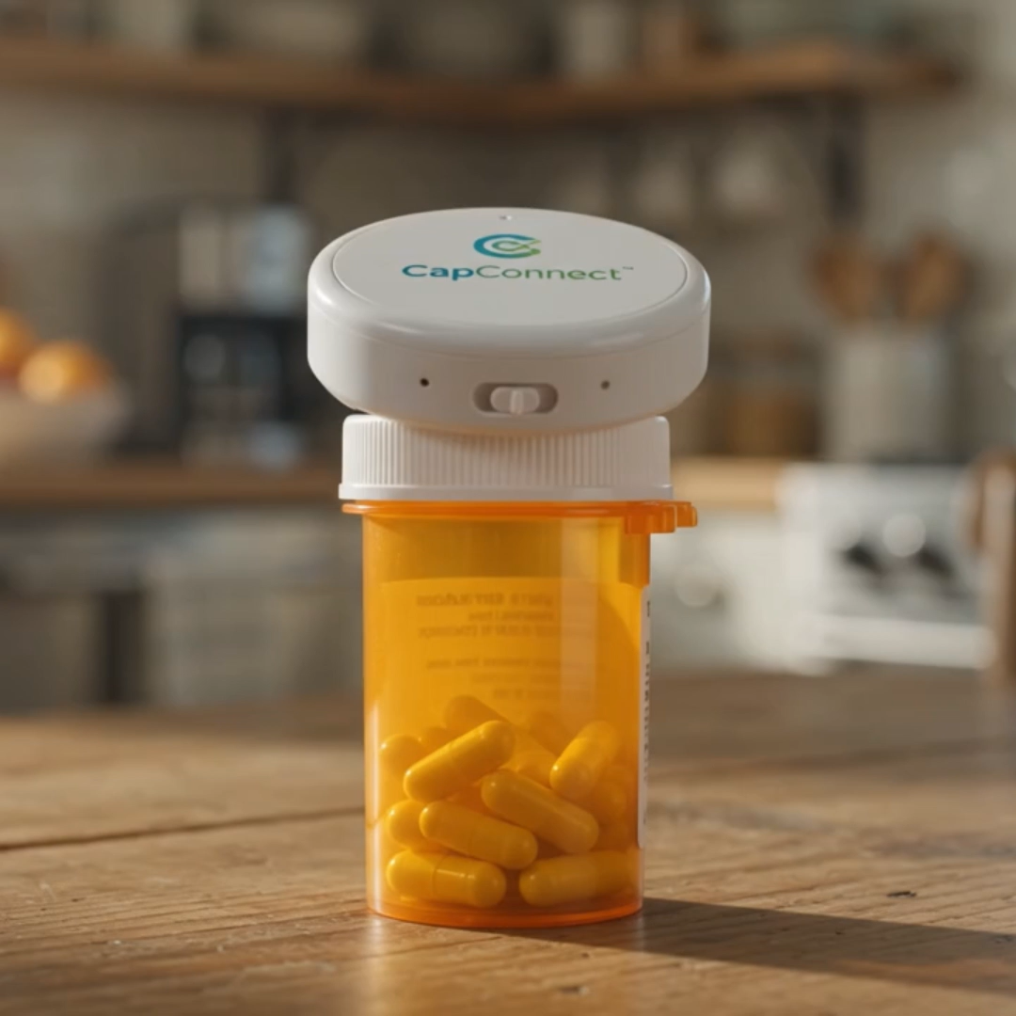
CapConnect is more than just a bottle cap; it is a vital bridge between a patient's health discipline and their family’s peace of mind. It doesn’t just transform an 'invisible' challenge into a 'visible' solution it saves lives.

Slide 5
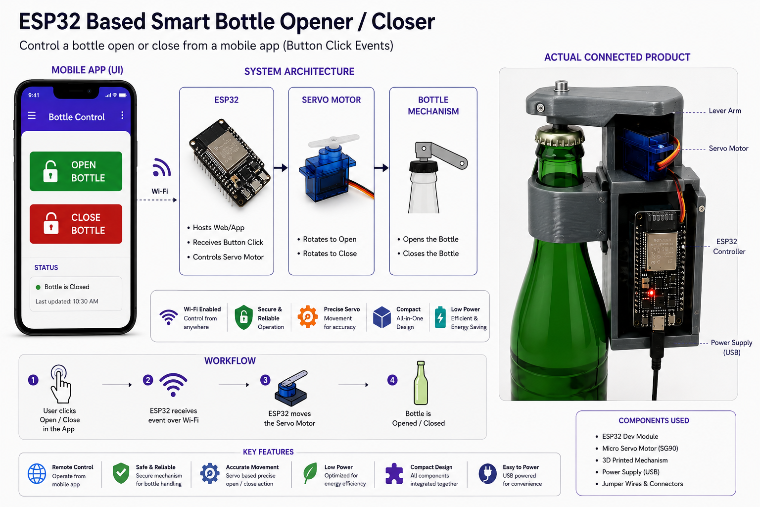

Slide 6
CAPCONNECT | THE WORKING CONCEPT
Sensing, Alerting, and Built for Adoption
A working concept that pairs simple IoT sensing with a caregiver notification system—designed for easy adoption by elderly users.
01
SIMPLE IoT SENSING
A low-cost sensor in the bottle cap quietly detects whether a dose was taken—no apps to learn and no buttons to remember.
02
CAREGIVER ALERTS
If a dose is missed, the system automatically notifies a family member or caregiver—turning a silent lapse into a timely nudge.
03
BUILT FOR ELDERLY USERS
Every design choice favors ease of adoption—it works with the patient’s existing routine, so there’s nothing new to learn.

Slide 7
CAPCONNECT | THE SOLUTION
More Than a Cap—A Life-Saving Companion
CapConnect bridges the gap between a patient’s daily medication routine and their family’s peace of mind.
By combining simplicity with smart technology, it turns an invisible problem into a visible, reliable solution—keeping patients safe, independent, and healthier every day.
VISUAL SIGNALS
Clear at-a-glance indicators show whether today’s dose has already been taken—removing confusion and preventing double doses.
VOICE ALERTS
Spoken reminders prompt the user at the right moment, making the routine effortless for those who struggle with screens.
REAL-TIME TRACKING
Every action is recorded and synced to a connected app, so caregivers stay informed and reassured at all times.

